Slide 1
Model A Ford Wiring
Keeping the Current Flowing
Notes:
Model A Ford wiring is a simple electrical system. In its day the wiring was straight forward.
Most books and the RG&JS us a schematic diagram with various symbols to show the electrical circuits. The diagrams are used because a word description would be lengthy, unfortunately the diagrams seldom help the restorer installing wiring or troubleshooting problems.
Today I am going to try to explain the wiring of the Model A.

Slide 2
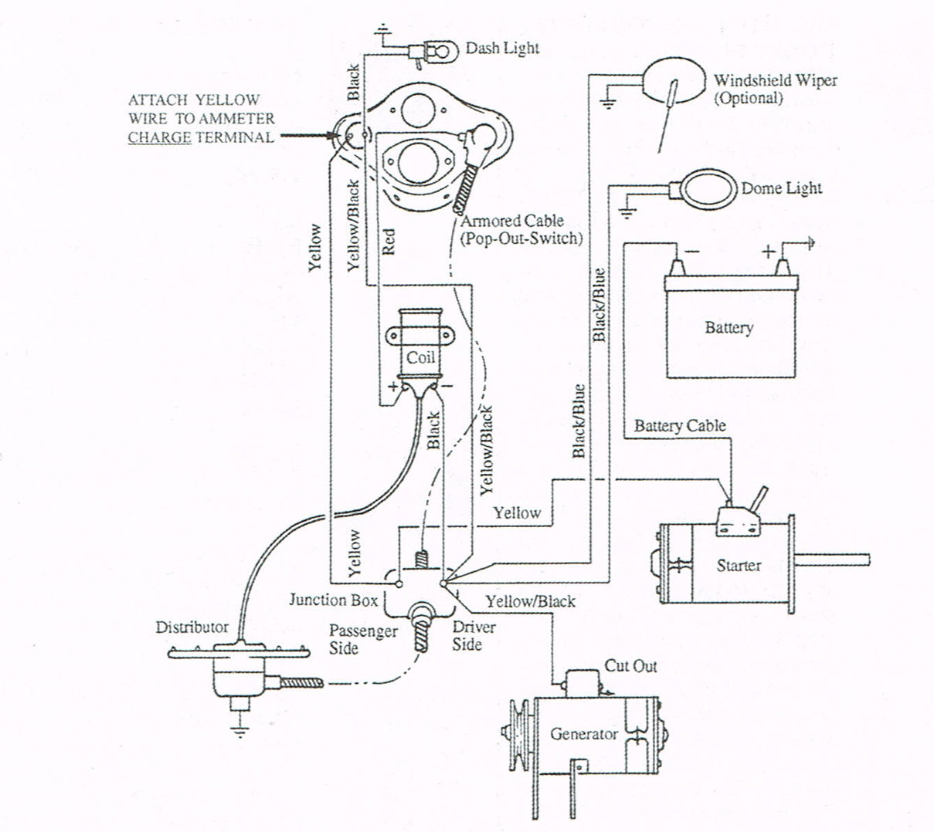
Notes:
This is a modified schematic diagram showing some wiring and a cartoon representation of various components.

Slide 3
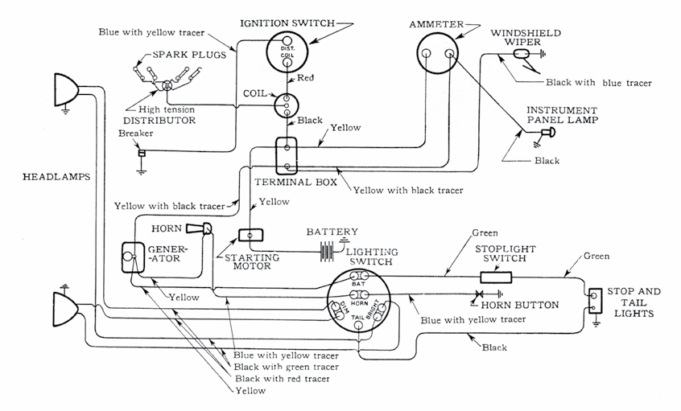
TYPICAL WIRING DIAGRAM (NO COWL LAMPS) 1928 TO MARCH 1929
Notes:
This is a schematic from the RG&JS. I have highlighted were it is different from the next diagram which is also from the Standards

Slide 4
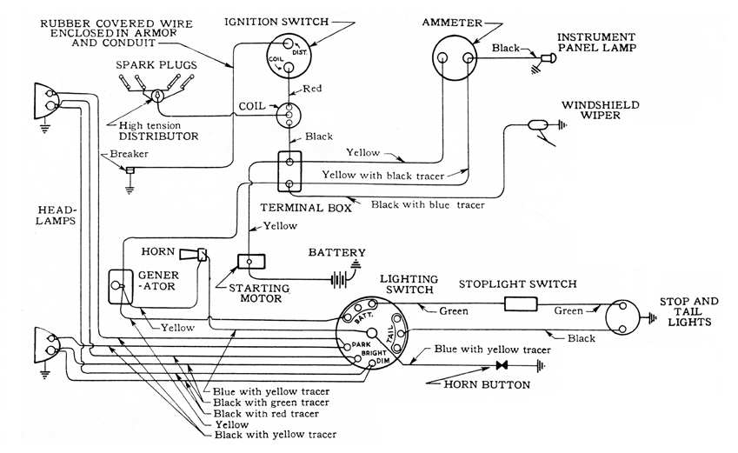
TYPICAL WIRING DIAGRAM (WITHOUT COWL LAMPS) beginning in February 1929
Notes:
This is the diagram from February 1929 to the end of production. The early cars had a number of variations, for simplicity I will primarily use a late 1930 vehicle as an example. The same general wiring was used in all vehicles if they had a powerhouse generator or a later model and the 1930 examples are characteristic.

Slide 5
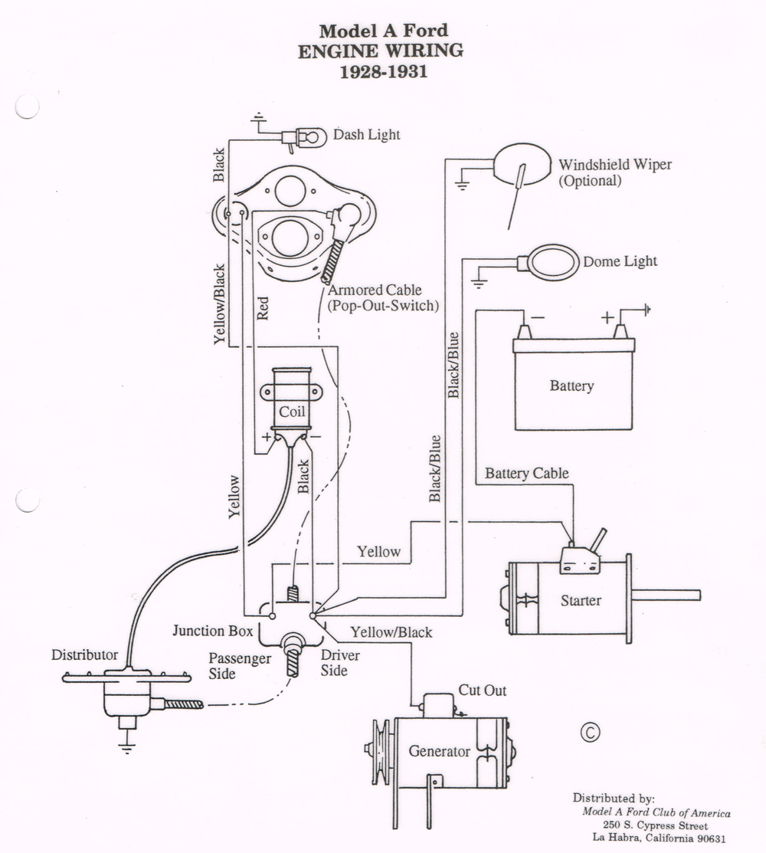
Notes:
You may have noticed these diagrams have some disagreement on which wire attaches to the discharge side of the amp meter. For this presentation we are attaching the yellow with black tracer to the discharge side. It is easy to check, prior to securing the dash to the gas tank, turn on the lights or hit the horn button. If it shows charge just reverse the two wires on the amp meter and install the dash.

Slide 6
About Ford Wiring
Wires were cloth covered, rubber insulated
Ford used 16 gauge wire on lamp wiring
Wire gauges in 1930’s not the same as today
Wires were bigger around, yet not as good
Modern materials
Better copper stands
6 Volt systems need a larger gauge than 12 volt to ensure good current flow
Notes:
With one exception, all lamp wiring harnesses used
16 gauge wire throughout.
Early 1928 vehicles using the first style switch had a heavier yellow wire to the
generator and a larger connector where it fastened to the
cutout.
On all lamp harnesses the outer cover was blackglazed cotton, tightly braided, providing a slight sheen (not “fuzzy”) when new.
The wires from the terminal box to the generator cutout and to the battery connection on the starter switch were larger 12-gauge wire.
The tracer on the generator to terminal box wire was the double spiral type.
The wire from the ignition switch to the coil (red wire) was 16-gauge until October 1928 when it was changed to 12-gauge.
The black wire from the coil to the terminal box was 16-gauge throughout production.

Slide 7
Stranded Wire vs Solid Wire
Stranded wire is much more flexible than solid wire of equal size. For this reason, stranded wire is used when the wire needs to move around frequently, in automotive applications or in appliances for example. Conversely, solid wire is used when little or no movement is needed, such as home wiring. When working with your Model A used stranded wire for the best results. Ford used only stranded wire.
Notes:
I have an example of an original harness up here that you can examine after we are done. It is all stranded wire, but after 85+ years even the stranded wire is being stiff and losing its flexibility.
This is why replacing your wiring is important when performing a restoration. It can become brittle and break creating a short.

Slide 8
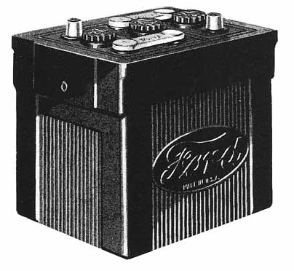
The Battery – Where it All Starts
Notes:
The Model A uses a
6 volt
Positive ground
80 Ampere hours, Group 1 battery
It has a charging rate of 10 to 12 amps
When cranking the starter may draw as much as 180 so a good fully charged battery is a key element in the Model A’s performance

Slide 9
Battery
Correct polarity – 6V ground is Positive
Keep electrolyte levels correct – distilled water
Caps in place
Keep connections clean and tight
Keep fully charged – trickle charges a good idea
Do not over charge – 10 amps for average driving
Keep securely mounted
Connect ground strap last
Notes:
Some important considerations about your battery are shown here:
The Model A battery sits under the floor board on the driver’s side and getting to it is not easy. The access door under the carpet or floor mat provides some access, but to really service it and check all connections the floorboard must be removed.
I use Di-Electric grease on the battery terminals once they are connected.

Slide 10
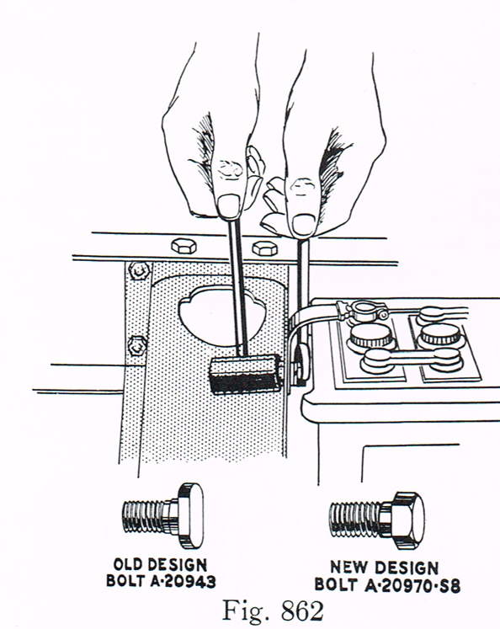
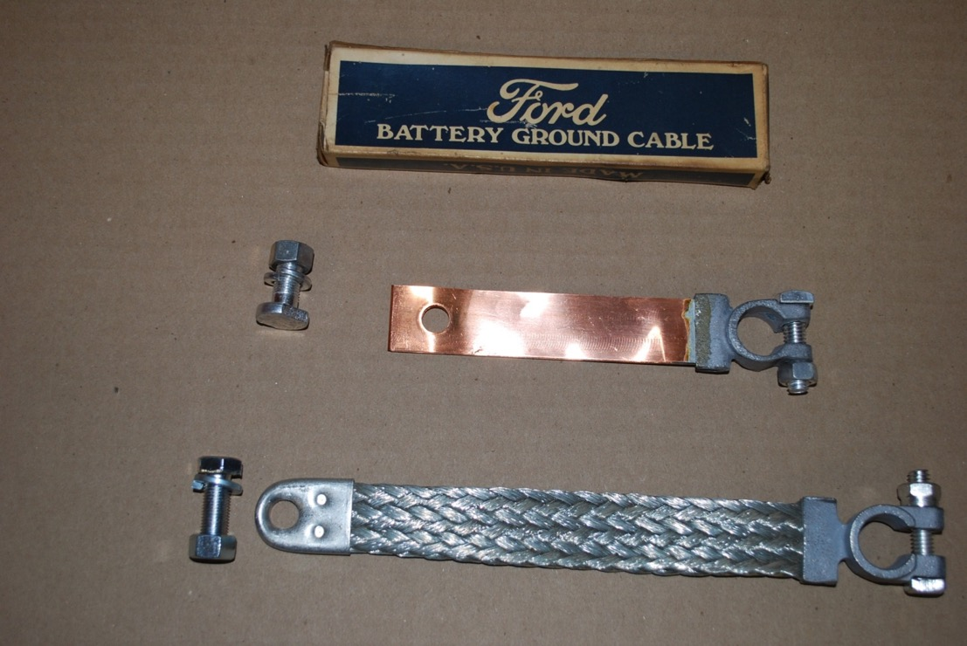
Battery Ground Cable
Service Bulletin - March 1930
Notes:
The ground strap assembly was 4-3/4” long through 1929 when it was reduced to 4-1/4” (measured on hole centers).
Beginning June 1931 the braided strap was also used.
The straps shown are those currently provided by the vendors. You will notice the braided style is a little too long, which means you either have to twist it around a little or modify it. Once again original parts are always best.

Slide 11
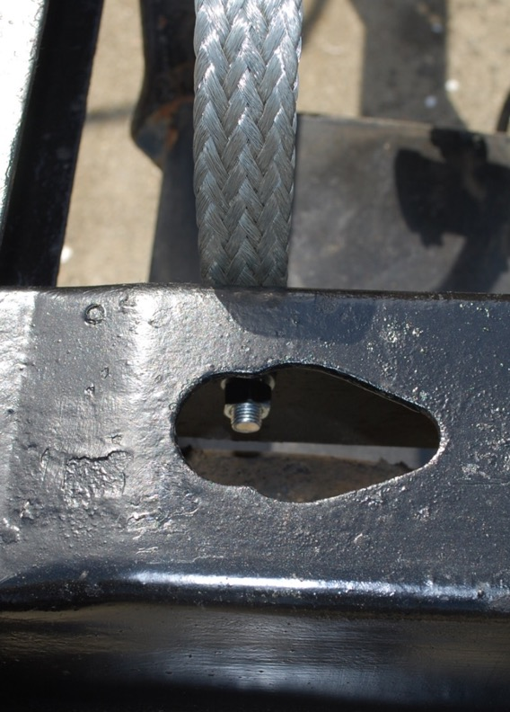
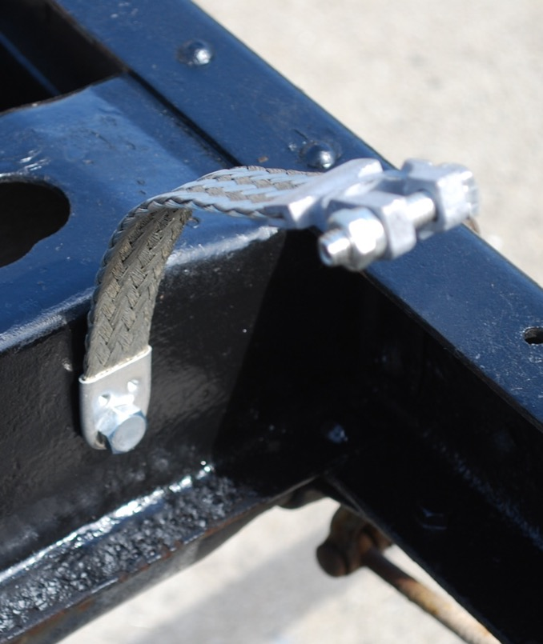
Ground Cable Attached
Notes:
When installing the ground strap, I clean off a little paint in the bolt hole and under where the strap makes contact. Emery cloth is a good tool for cleaning up an area to ensure metal to metal contact. A good ground is essential for a 6 volt system. This is particularly true in the Model A since there are no wires returning to the battery. The metal body and frame carry the return current to keep the battery charged.

Slide 12
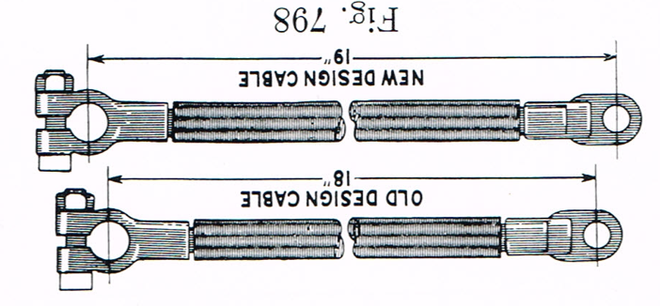
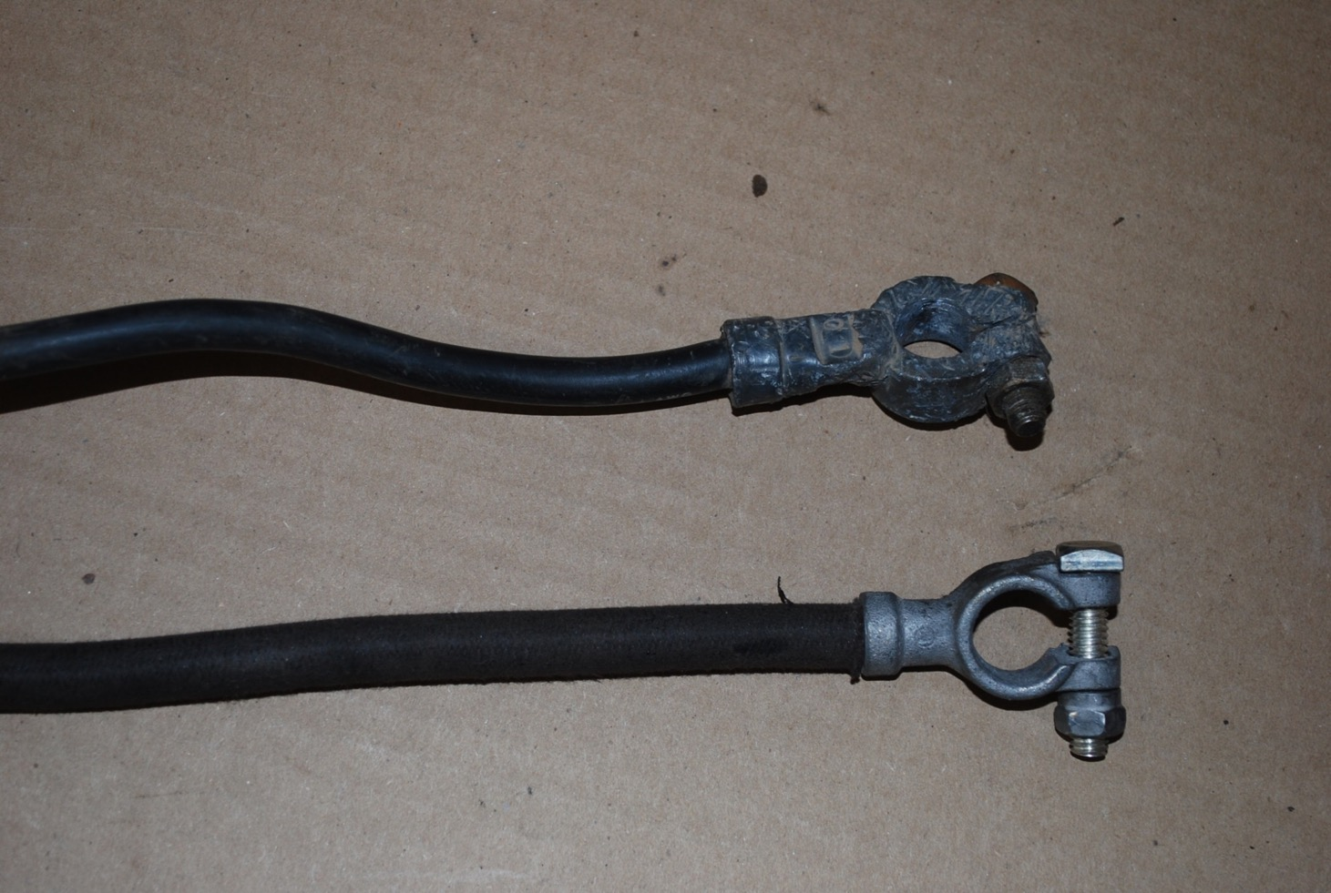
Service Bulletin – November 1929
Modern Cable #2 wire
Model A Cable #1 wire
Notes:
The upper cable is a “modern” one from NAPA, Pep Boys or other store. It is a number 2 wire while the Model A used a number 1 wire = bigger cable. Our 6 volt system provide better performance with the larger wire so I recommend one of the cables available from the vendors.

Slide 13
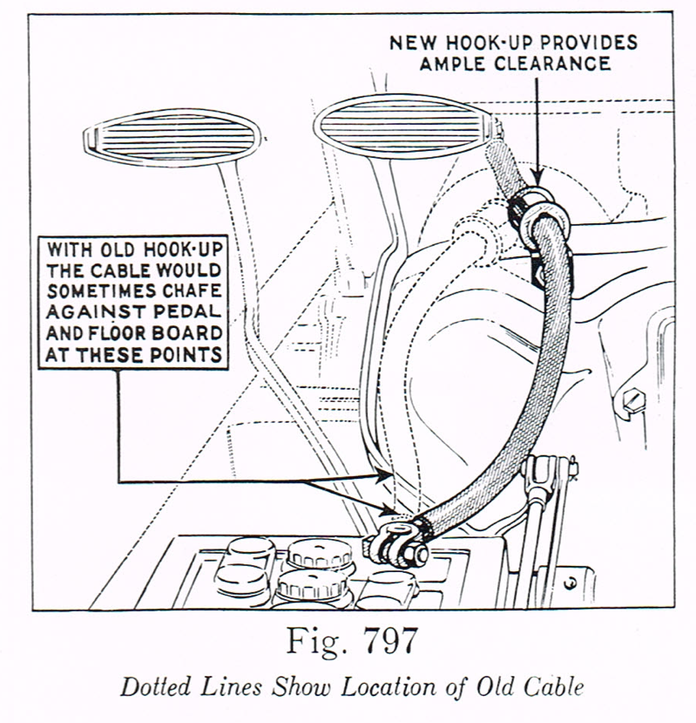
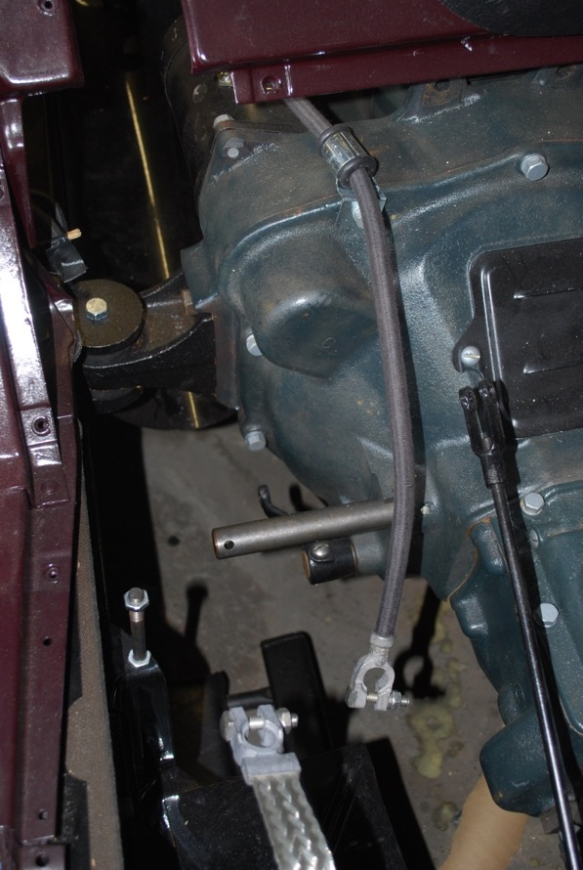
Battery Cable Routing
Service Bulletin – November 1929
Notes:
The Ford Service Bulletins contain a world of useful information. Here is one from November 1929 showing the improved routing of the cable. I hope you all have a copy in your library – it can answer many of your questions.

Slide 14
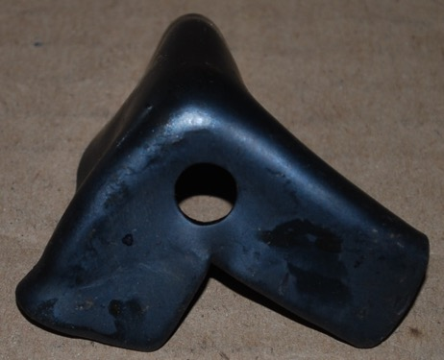
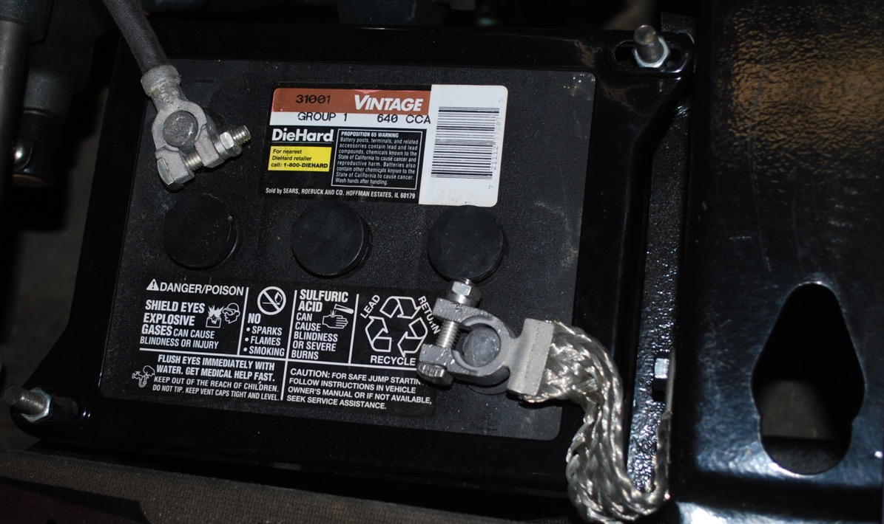
Battery Mounted
Use care to ensure no contact with battery hold down
Notes:
Ground cables from vendors are often too long and require some twisting to install – Ford cable was 4 ½” long
Battery must be firmly mounted – Ford used three different brackets
Complete surround has potential to short at connection, must be careful when mounting

Slide 15
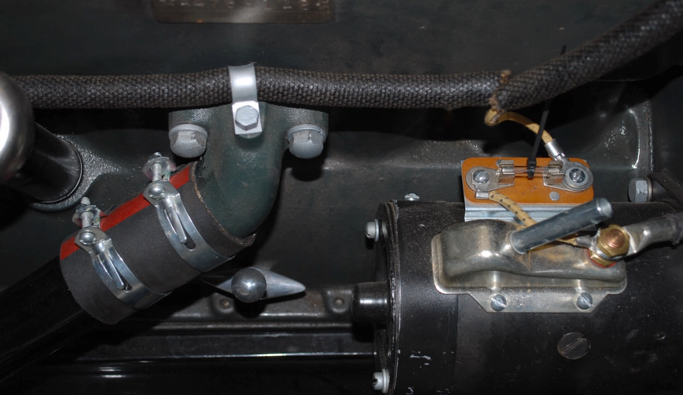
Safety Fuse
Black Enamel Paint
Notes:
The cable attaches to the starter switch post. This connection must be tight as a lot of current flows when the starter is engaged.

Slide 16
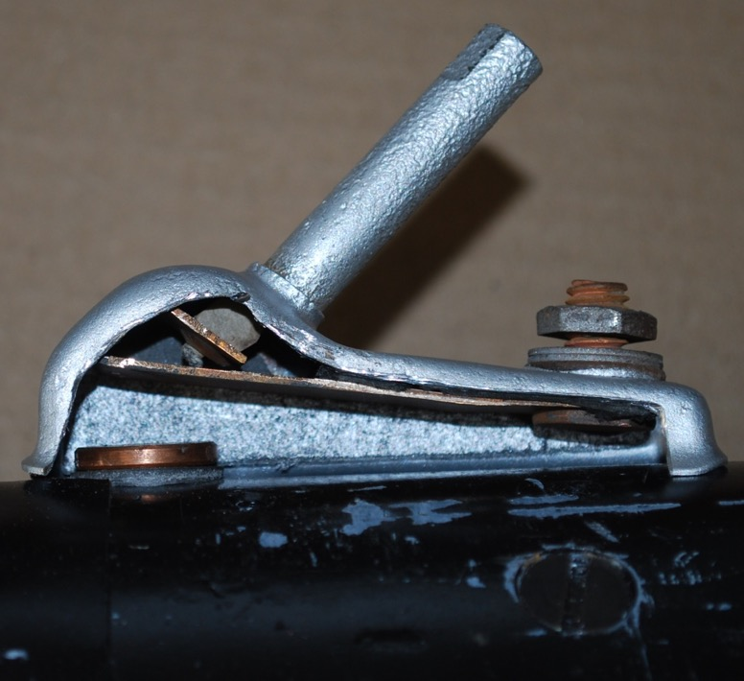
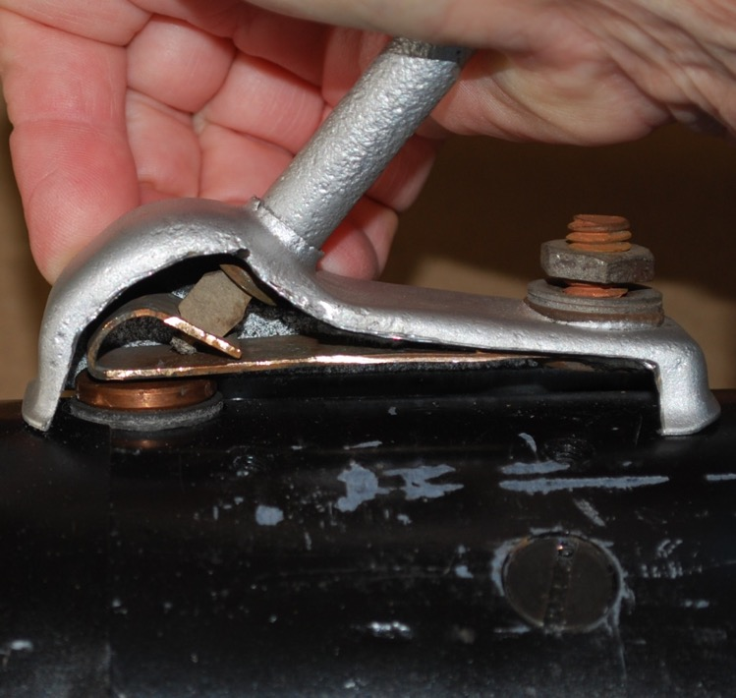
Starter Switch
Notes:
Occasionally starter switch will “stick” and you must tap with screwdriver / hammer to loosen
Take switch off and clean connection = solved problem

Slide 17
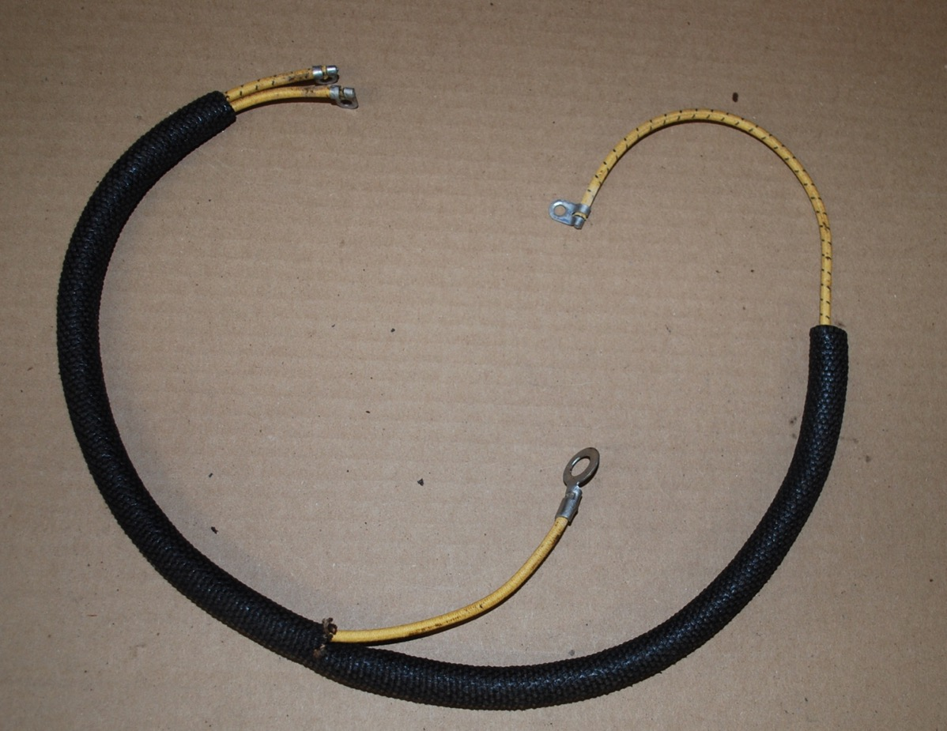
Cut Out to Terminal Box Wiring Harness
To Terminal Box – Yellow wire to passenger side
To Generator Cutout
To Starter Switch Post
Notes:
The Model A has three significant wiring harness, this is the first.
Consists to two wires in a loom:
Yellow with black tracer from driver’s side terminal box to cutout on generator
Yellow wire from passenger side of the terminal box to starter switch post or fuse connection. This is a 12 gauge wire.
This wiring was placed in a metal tubing through February 1930 –then in a flexible loom until the end of production.

Slide 18
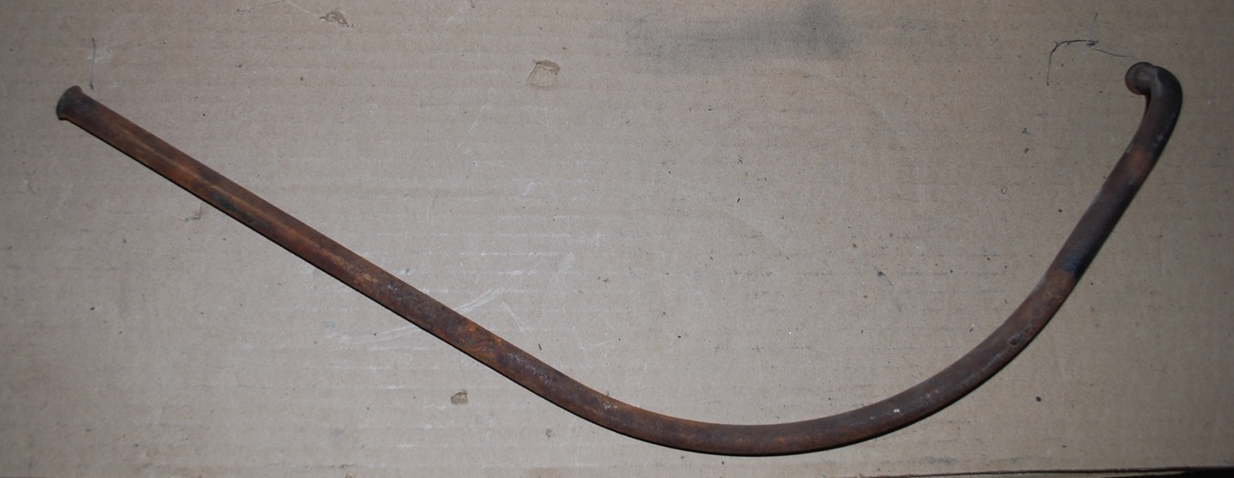
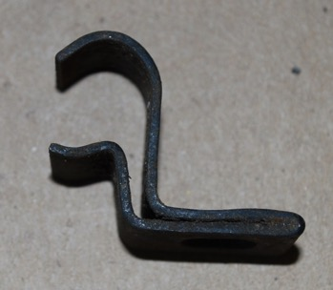
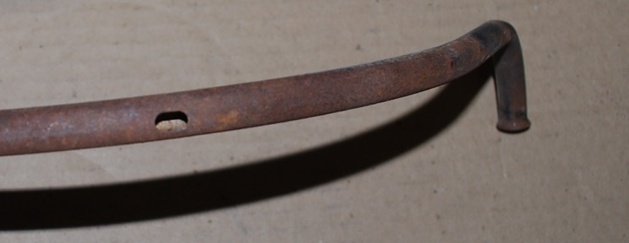
1928-1929 Models Used a Steel Conduit
Painted Black Enamel
Firewall
Clip for
Conduit
Hole for Wire to Starter Switch
Notes:
Here is an original conduit, it is no longer shinny black, but shows the shape and the hole for the starter switch wire. This wire is how the ignition system gets its current.

Slide 19
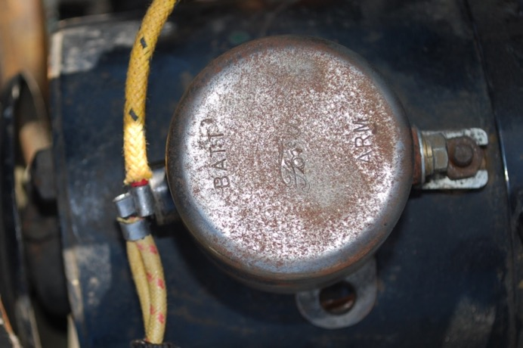
Connections
Terminal Box
Generator Cut Out
Notes:
There were a number of different cutout
Earlier generators had wiring connected at rear

Slide 20
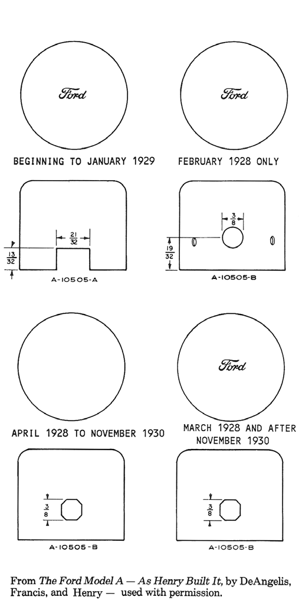
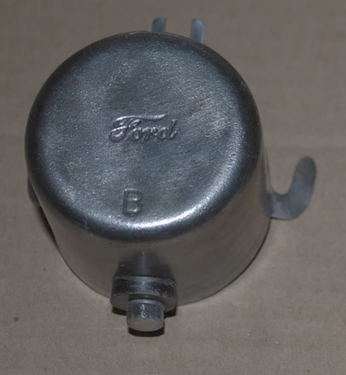
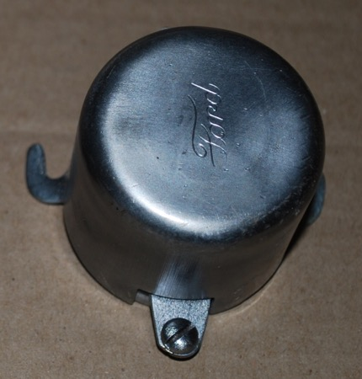
Cut Out Variations

Slide 21
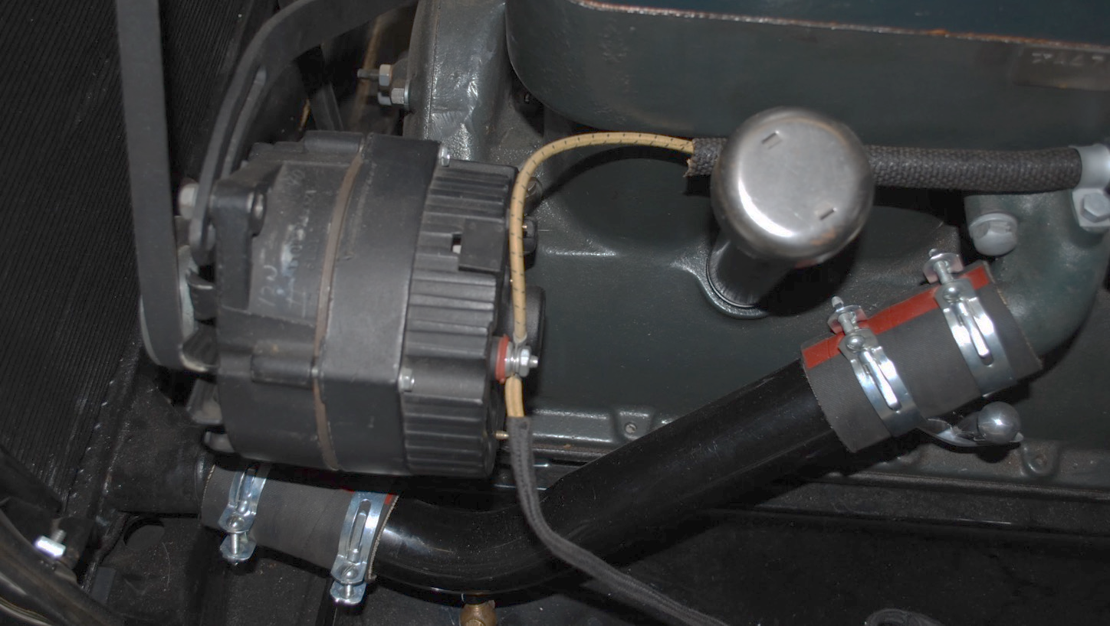
Alternator

Slide 22
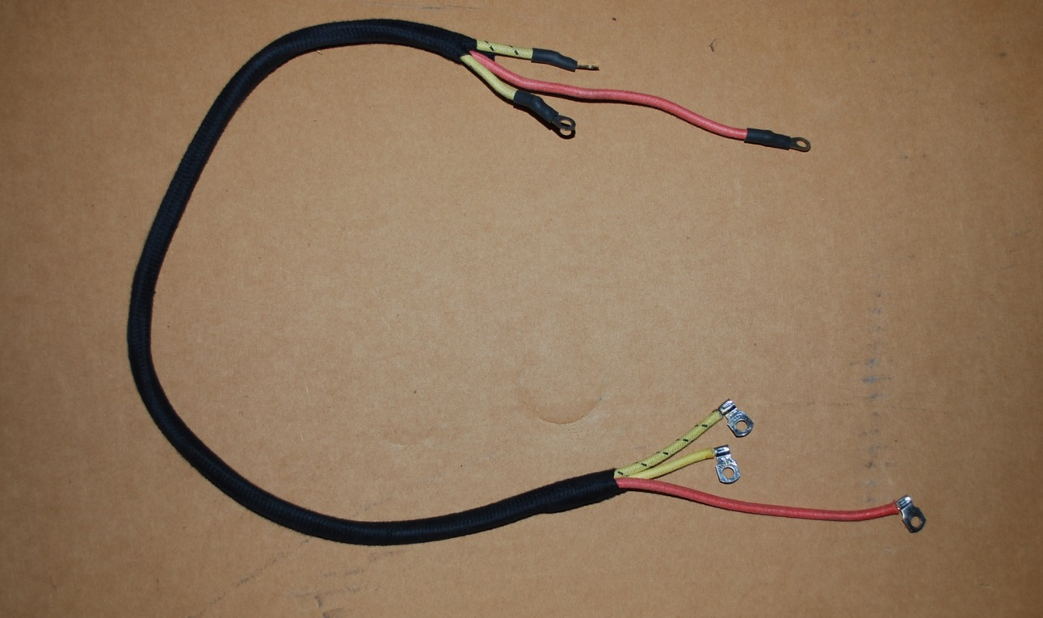
Dash Wiring to Terminal Box Harness
Amp Meter Discharge Side
Igniton Switch
Amp Meter Charge Side
Terminal Box
Driver’s Side
Passenger’s Side
Coil Positive Post
Notes:
This loom contains three wires:
Red wire from the ignition switch to the coil – heavy 12 gauge wire
Yellow wire to ammeter discharge side
Yellow wire with black tracer to ammeter chare side

Slide 23
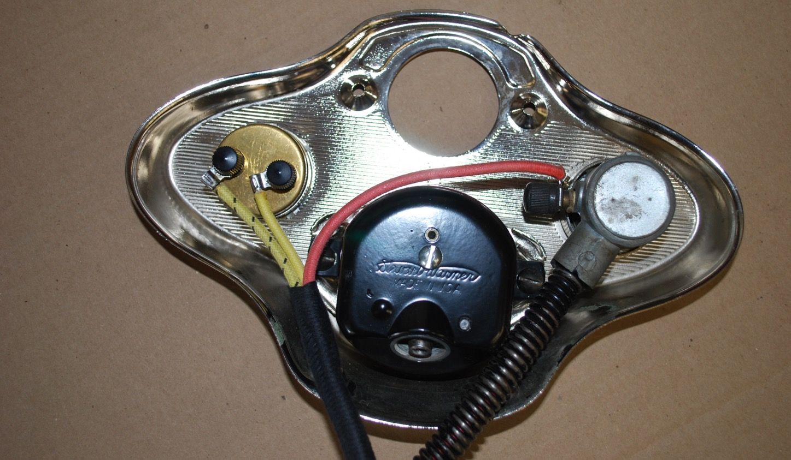
Dash Connections
Discharge Side
Notes:
Some wiring diagrams show the connections to the amp meter reversed. When installing it is easy to determine if you are correct – before attaching the dash look at the meter, turn on your lights or honk the horn and the meter should show discharge. If it shows charge, just reverse the connections. As shown is Les’ book and the Shop Drawings diagrams and my car.

Slide 24
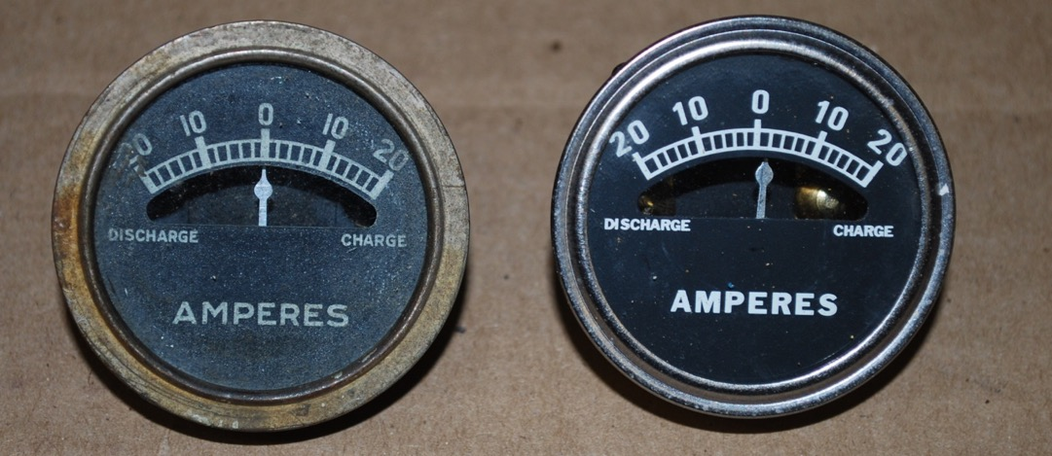
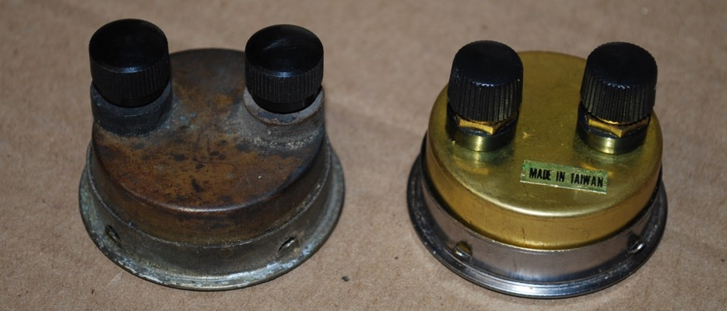
Ammeter

Slide 25
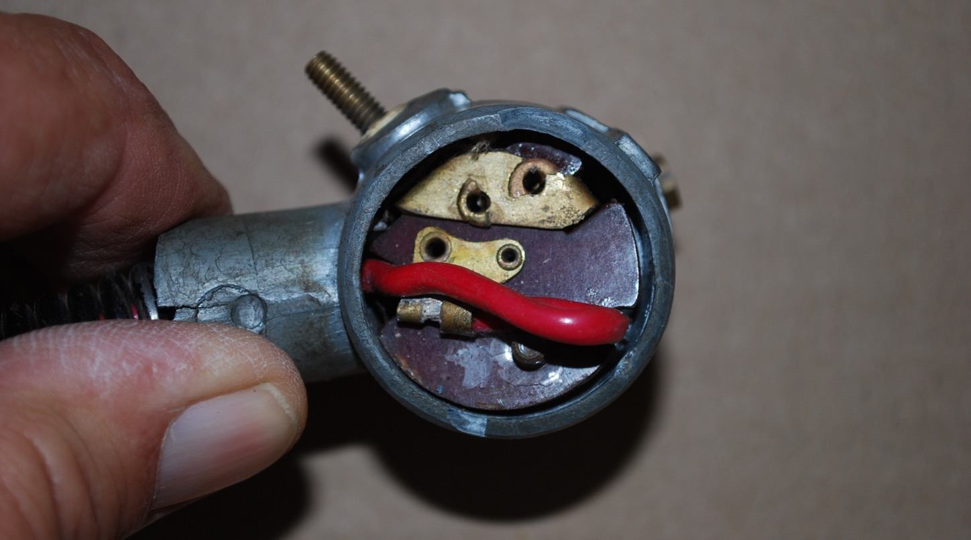
Pop Out Switch Internal

Slide 26
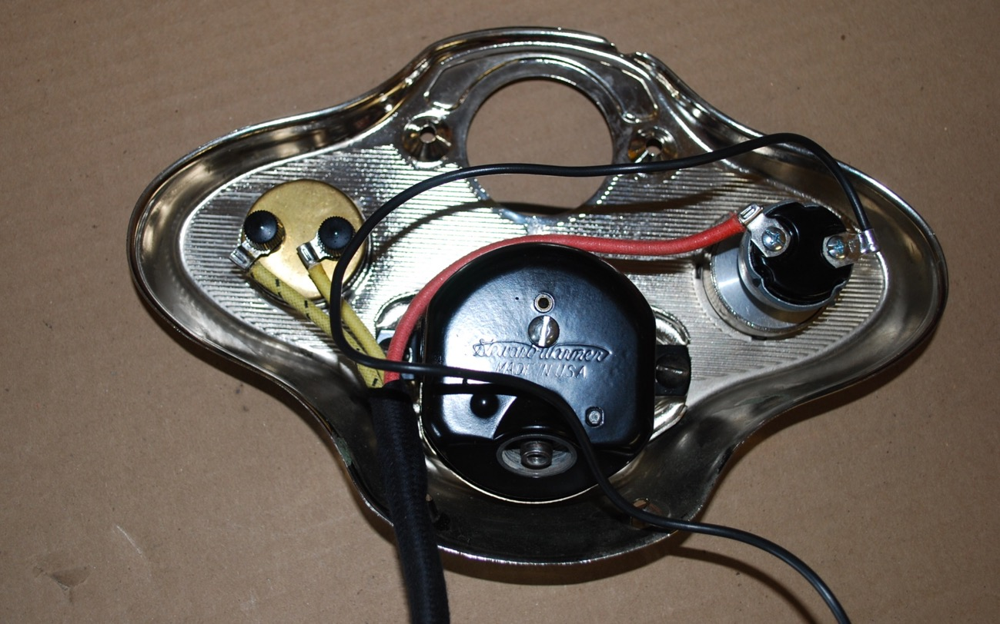
Dash with Replacement Switch
Discharge Side

Slide 27
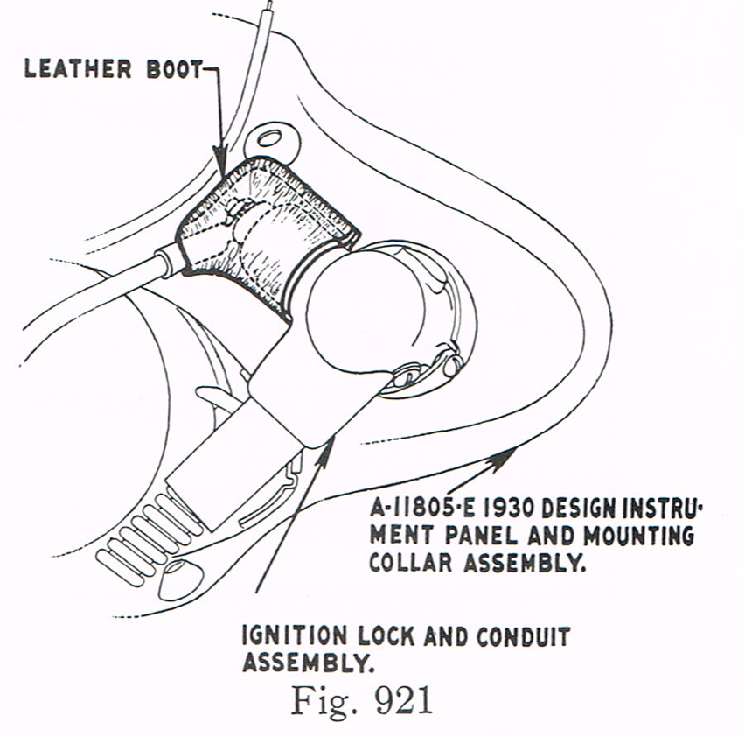
Clearance is Minimal – Protect Connections
Service Bulletin
June 1930
For trucks, but
dash and gas tank
are the same

Slide 28
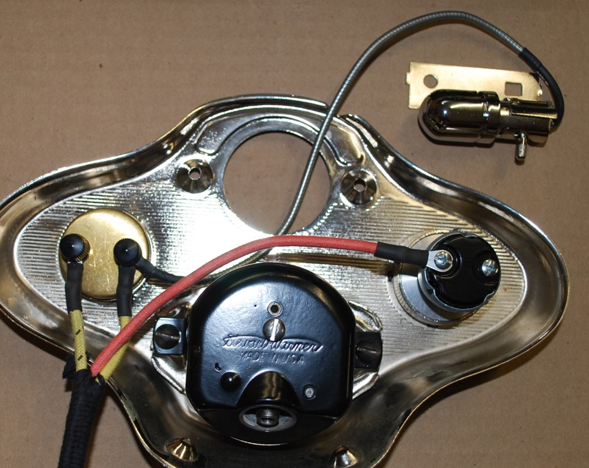
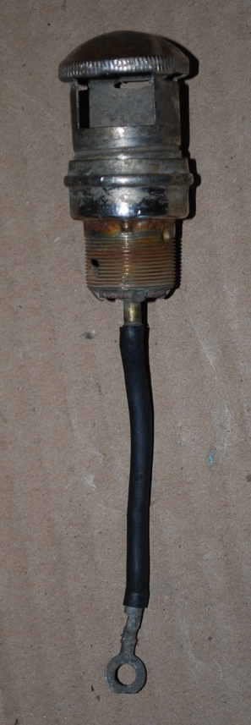
Instrument Light Connection

Slide 29
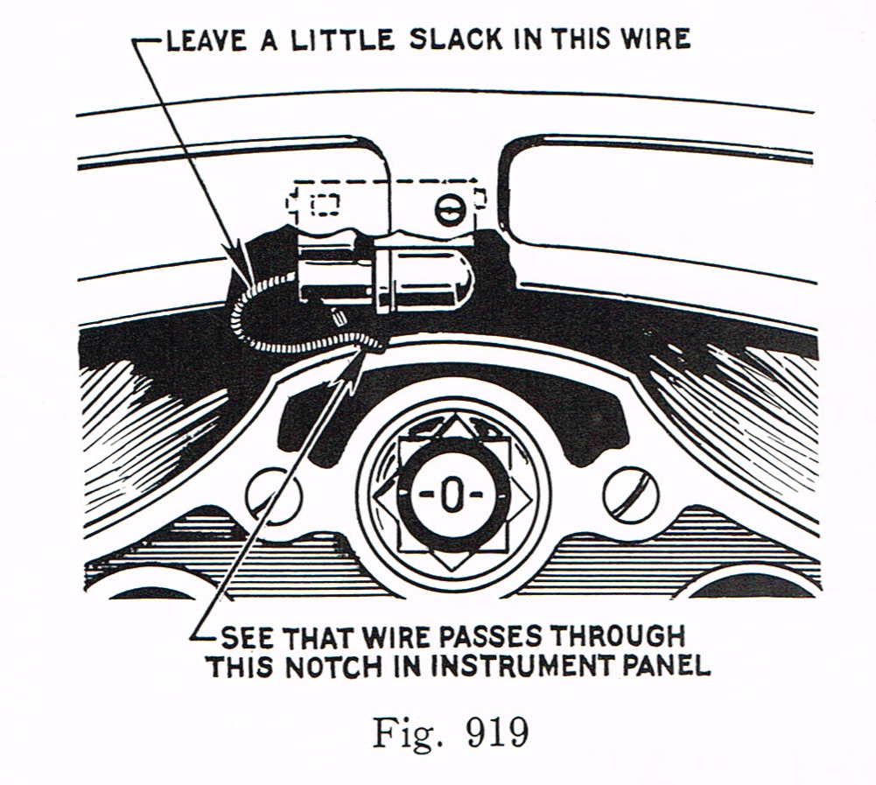
Slack in Instrument Light
Service Bulletin
June 1930

Slide 30
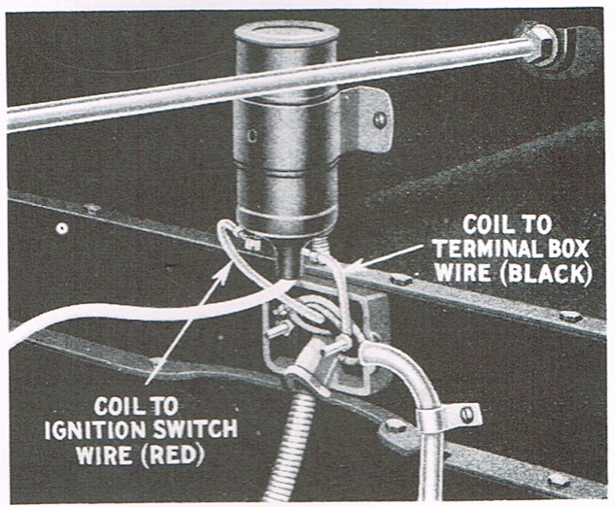
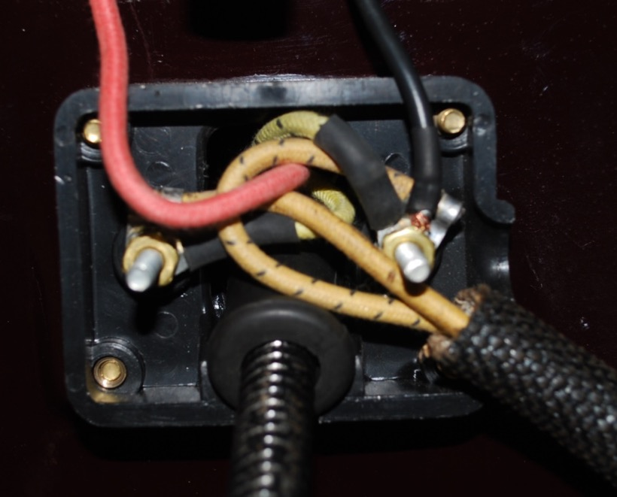
Terminal Box Connection
Coil Wire
New Hook-up
Service Bulleting – November 1929

Slide 31
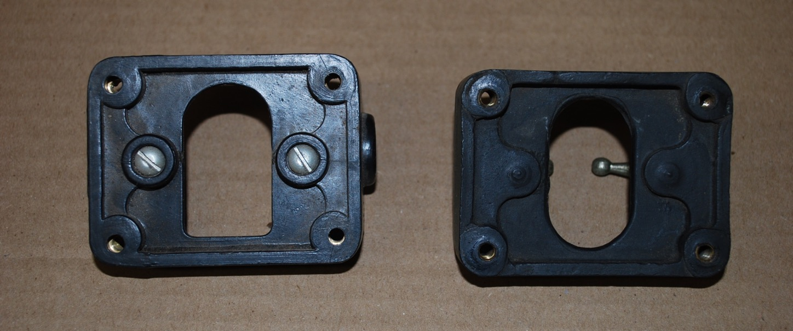
Terminal Box Reproduction vs Original
Backside of Reproduction
Backside of Original

Slide 32
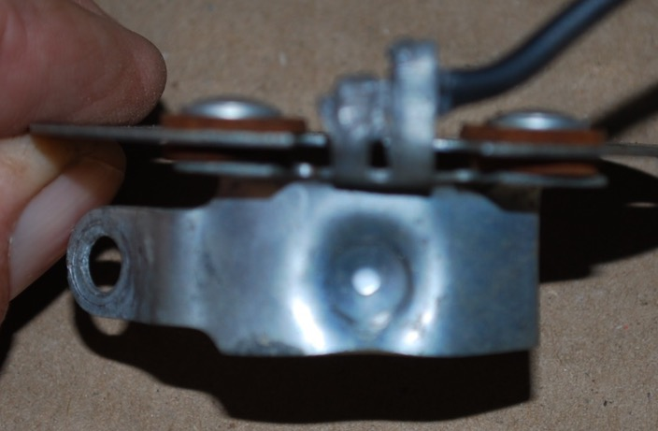
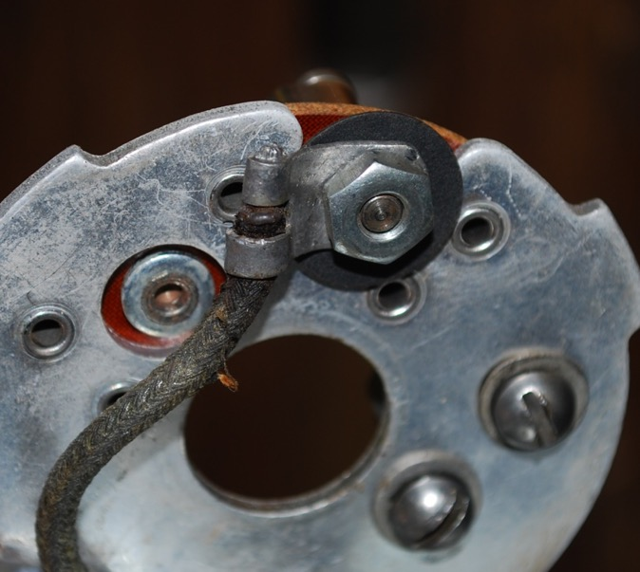
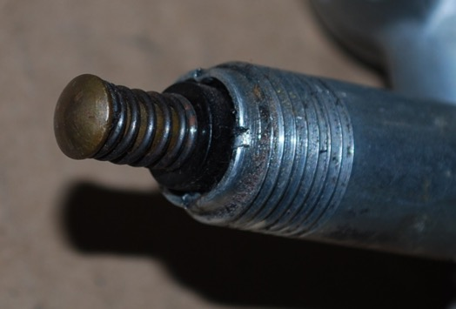
Ignition Wiring
Lower plate wire to upper plate connection

Slide 33
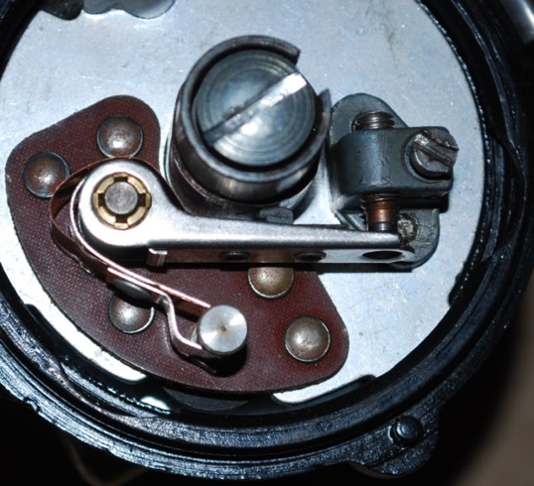
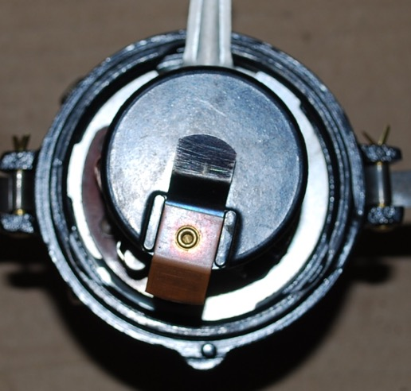
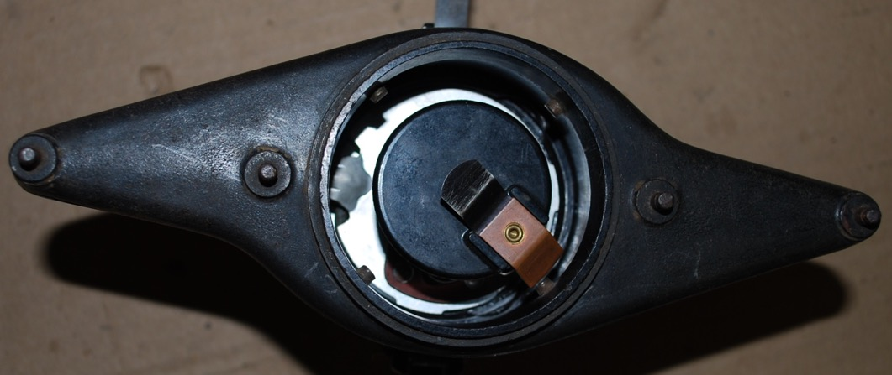
Distributor

Slide 34
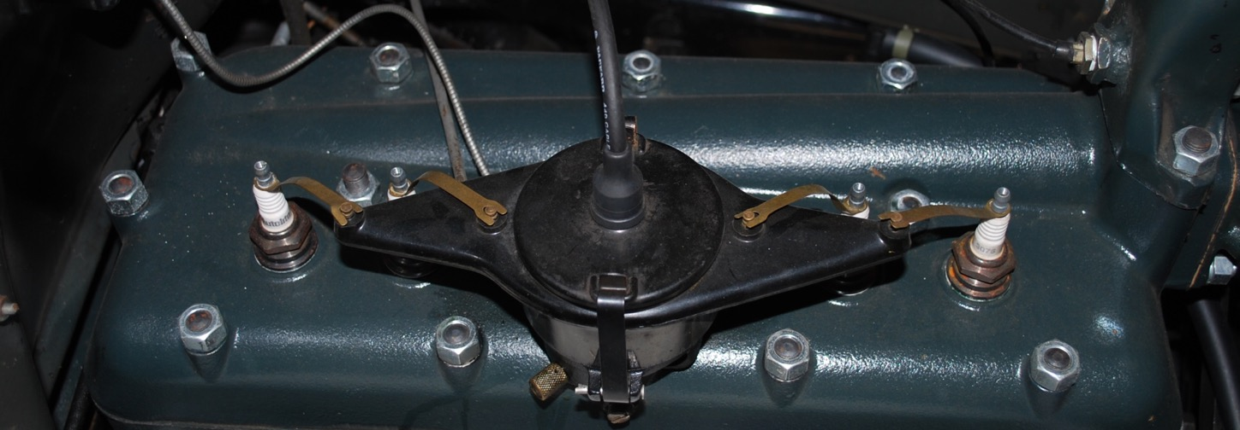
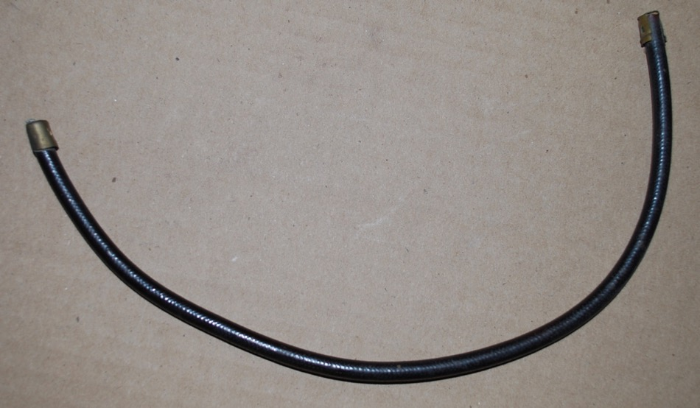
Modern Coil Wire
Original Coil Wire

Slide 35
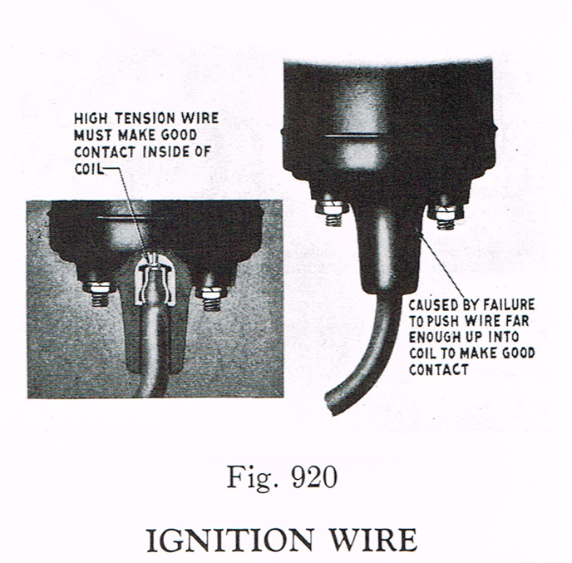
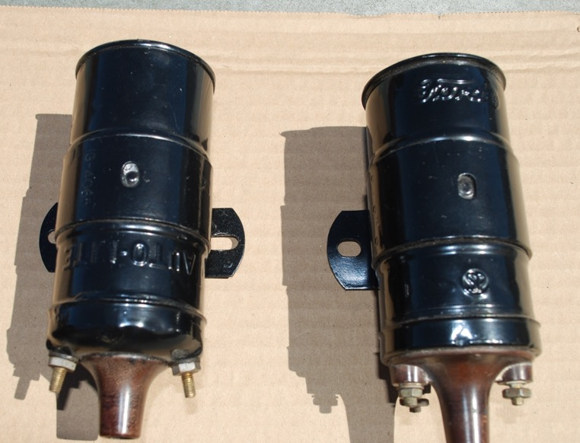
Coil
Service Bulletin – June 1930
Notes:
You will remember that in 1929 the wiring to the coil was changed. This change provides the correct polarity for the coil. Coils work either way, but then the polarity is correct the spark is “hotter”.
The wire from the ignition switch goes to the passenger side and since the car is a positive ground this mean the negative post is on the passenger side.

Slide 36
Main Wiring Harness

Slide 37
Light Switch Housings
First Design
Open Bail
After Feb. 1928 W/ Twolight to April 1930 After Feb. 1930

Slide 38
Reproduction Light Switch Cover
Flat Surface

Slide 39
Light Switch Connections – Used After February 1928 with Ford “H” Headlights (Fluted Lens)

Slide 40
Light Switch Connections Used with Twolight headlamps

Slide 41
Wiring Harness w/ Cowl Lights
Bauer Electronics – Used with Permission

Slide 42
Light Connection

Slide 47
Switch Attachment

Slide 49
Wiring Clip Under Hood Latch
Service Bulletin –
April 1929

Slide 50
Service Bulletin – June 1930

Slide 52
Horn Connection

Slide 53
Horn Rod
Pressing Button Completes Circuit to Ground
Plastic Insulator

Slide 54
Headlight Connection

Slide 55
Courtesy of Bratton’s Antique Auto Parts

Slide 56
Headlight Wire Plug Connection
Service Bulletin – May 1930

Slide 57
Headlight Socket Connections

Slide 58
Headlight
Courtesy of Bratton’s Antique Auto Parts

Slide 59
Inside Headlight

Slide 61
Main Wiring Harness – Going to Rear
Notes:
Wire routing
The rear lamp wiring was routed under the rear motor mount to the bottom inside of the left rail and fastened with a clip.
It was then routed through the center cross member with the transmission mounted stoplight switch or under the cross member with the cross member mounted switch
Then along the bottom inside of the lower left rail, fastened with three clips.
The harness was routed to the frame upper rear corner bracket where it was fastened with a clip.
Passenger vehicles with the drum type rear lamp had two clips holding the wires to the lamp support. Later models had the lamp extension wires attached to the rear fender bracket or fender skirt with a special clip.
Beginning early 1929 a clip (A- 14592) was used to support the wiring to the bottom of some wood framed bodies just rearward of the rear cross member.

Slide 62
Wiring to Stop Light Switch

Slide 63
Stop Light Switch

Slide 65
Tail Light Connection

Slide 67
Tail Light (s)

Slide 68
Wire Clips
1 - A-14585 Rear harness to frame clip.
5 req.
2 - A-14565 Rear harness to fender
bracket or skirt. Used with teacup
style rear lamp. 1 req.
3 - A-14595-A Rear harness to lamp
bracket. Used with drum style rear
lamp. 2 req.
4 - A14592 Rear lamp harness to body.
used on most Fordor bodies and many
commercial bodies.

Slide 71
Notes:
Dielectric grease is electrically insulating and does not break down when high voltage is applied. It is often applied to electrical connectors, particularly those containing rubber gaskets, as a means of lubricating and sealing rubber portions of the connector without arcing. It can be applied to the actual contact as well, because the contact pressure is sufficient to penetrate the grease film. Doing so on contact surfaces between different metals has the advantage of sealing the contact area against corrosion.

Slide 73
Tail Light Loom

Slide 74
Cross Over Wire – Dual Tail lights
Notes:
There is a loom for the cross over wire, similar to that used for the tail light. The cross over wire is held with wire clips and usually run along the back of the body.

Slide 75
Cowl and Dome Lights
Service Bulletin
June 1930
Notes:
The main wiring harness has a short wire extending from the light switch housing. This connects to the cowl light crossover wire. The wires route along the backside of the firewall and are beneath the cowl panels (kick panels).

Slide 76
Cowl Light Connectors / Clips
Cowl lamp harness connector (1929-31) and frame clip. “C” shaped connector clip was used in 1929. The“S” shaped frame clip was used on 1930-31 models.

Slide 77
Cowl Light

Slide 78
Service Bulletin
October 1930

Slide 79
Turn Signals
Bauer Electronics – Used with Permission
Notes:
You can run your own wires to install turn indicators, however the vendors sell a main wiring harness setup for turn signals with all the various wires already in place and contained within the loom. It makes for a very neat looking installation. The connection that comes to the switch will accommodate all signal mechanism such as the hidden switch or the arm switch depending on your preference. I recommend turn signals as a safety item, particularly on car doing a lot of touring.

Slide 80
Trouble Shooting Tools

Slide 81
Where To Find Voltage
From Model A Ford Mechanics Handbook by Les Andrews – Available from MAFCA

Slide 82
Typical Problems
Problem
Probable Cause
Lights Bulbs Burn Out Often
Horn Inoperative
Ammeter Shows Discharge
Poor Ground Between Battery & Generator
Dirty Armature
Poor Connection at Light Switch
Defective Horn Rod
Defective Generator
Defective CutOut

Slide 83
Typical Problems (Cont.)
Problem
Probable Cause
Ammeter Shows High Charge
Tail Light Does Not Work –Good Bulb
Generator Out of Adjustment
Poor Ground or Wire Connection

Slide 84
Ignition Trouble Shooting
From Model A Ford Mechanics Handbook by Les Andrews – Available from MAFCA

Slide 85
Preliminary Test
Test for 6V at Starter
Test for 6V at both Terminal Box Nuts
Test for 6V at both Coil Terminals
Open Point – Insert Piece of Paper – Then turn on Ignition (Key On) – Test for 6V on Arm
If any test failed, trace the fault to a disconnected or broken wire in the circuit

